Slide 1
Unit 2 Computer Arithmetic
Lecture 1

Slide 2
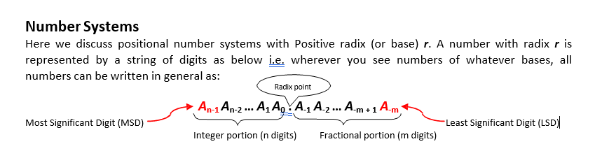

Slide 3
Decimal Number System (Base-10 system)
Radix (r) = 10
Symbols = 0 through r-1 = 0 through 10-1 = {0, 1, 2... 8, 9}
starting from base-10 system since it is used vastly in everyday arithmetic besides computers to represent numbers by strings of digits or symbols defined above, possibly with a decimal point. Depending on its position in the string, each digit has an associated value of an integer raised to the power of 10.
Example: decimal number 724.5 is interpreted to represent 7 hundreds plus 2 tens plus 4 units plus 5
tenths.
724.5 = 7 X 10^2 + 2 X 10^1 + 4 X 10^0 +5 X 10^-1

Slide 4
Binary Number System (Base-2 system)
Radix (r) = 2
Symbols = 0 through r-1 = 0 through 2-1 = {0, 1}
A binary numbers are expressed with a string of 1'sand 0's and, possibly, a binary point within it. The decimal equivalent of a binary number can be found by expanding the number into a power series with a base of 2.
Example: (11010.01)2 can be interpreted using power series as:
(11010.01)2 = 1 X 2^4 + 1 X 2^3 + 0 X 2^2 + 1 X 2^1 + 0 X 2^0 +0 X 2^-1 + 1 X 2^-2 = (26.25)10
Digits in a binary number are called bits (Binary digits).
When a bit is equal to 0, it does not contribute to the sum during the conversion. Therefore, the conversion to decimal can be obtained by adding the numbers with powers of 2 corresponding to the bits that are equal to 1.
Looking at above example, (11010.01)2 = 16 + 8 + 2 + 0.25 = (26.25)10 .

Slide 5
In computer work,
2¹⁰ is referred to as K (kilo),
2²⁰ as M (mega),
2³⁰ as G (giga),
2⁴⁰ as T (tera) and so on.

Slide 6
Octal Number System (Base-8 system)
Radix (r) = 8
Table: Numbers obtained from 2 to the power of n
Symbols = 0 through r-1 = 0 through 8-1 = {0, 1, 2…6, 7}
An octal numbers are expressed with a strings of symbols defined above, possibly, an octal point within it. The decimal equivalent of a octal number can be found by expanding the number into a power series with a base of 8.
Example: (40712.56)8 can be interpreted using power series as:
(40712.56)8 = 4 X 8^4 + 0 X 8^3 + 7 X 8^2 + 1 X 8^1 + 2 X 8^0 + 5 X 8^-1 + 6 X 8^-2 = (16842.1)10

Slide 7
Hexadecimal Number System (Base-16 system)
Radix (r) = 16
Symbols = 0 through r-1 = 0 through 16-1 = {0, 1, 2…9, A, B, C, D, E, F}
A hexadecimal numbers are expressed with a strings of symbols defined above, possibly, a hexadecimal point with in it. The decimal equivalent of a hexadecimal number can be found by expanding the number into a power series with a base of 16.
Example: (4D71B.C6)16 can be interpreted using power series as:
= 4x16^4+13x16^3+7x16^2+1x16^1+11x16^0+12x16^-1+6x16^-2
= (317211.7734375)10

Slide 8
Complements
Complements are used in digital computers for simplifying the subtraction operation and for logical manipulation.
There are two types of complements for each base-r system: r's complement and the second as the (r - 1)'s complement.
When the value of the base r is substituted, the two types are referred to as the 2's complement and 1's complement for binary numbers, the 10's complement and 9's complement for decimal numbers etc.

Slide 9
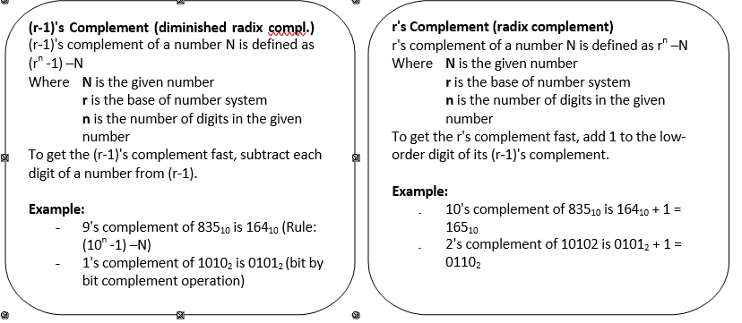

Slide 10
Subtraction with complements
The direct method of subtraction in elementary schools uses the borrow concept.
When subtraction is implemented with digital hardware, this method is found to be less efficient than the method that uses complements.
The subtraction of two n-digit unsigned numbers M - N in base-r can be done as follows:
Add the minuend M to the r's complement of the subtrahend N. This performs
M + (r^n–N) = M -N + r".
If M >= N, the sum will produce an end carry, r", which is discarded; what is left is the result M - N.
If M < N, the sum does not produce an end carry and is equal to r^n - (N - M), which is
the r's complement of (N - M). To obtain the answer in a familiar form, take the r's complement of the sum and place a negative sign in front.

Slide 11
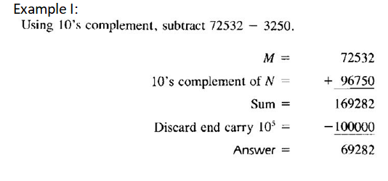

Slide 12
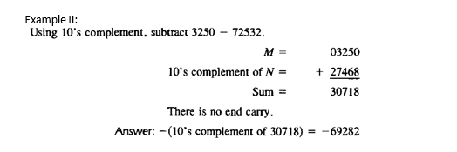

Slide 13
Perform the following (r’s complement)
234 – 1278
1234-567
345-1356
1789-367

